Slide 1
Millan vs. Farinotti
5/13/24

Slide 4
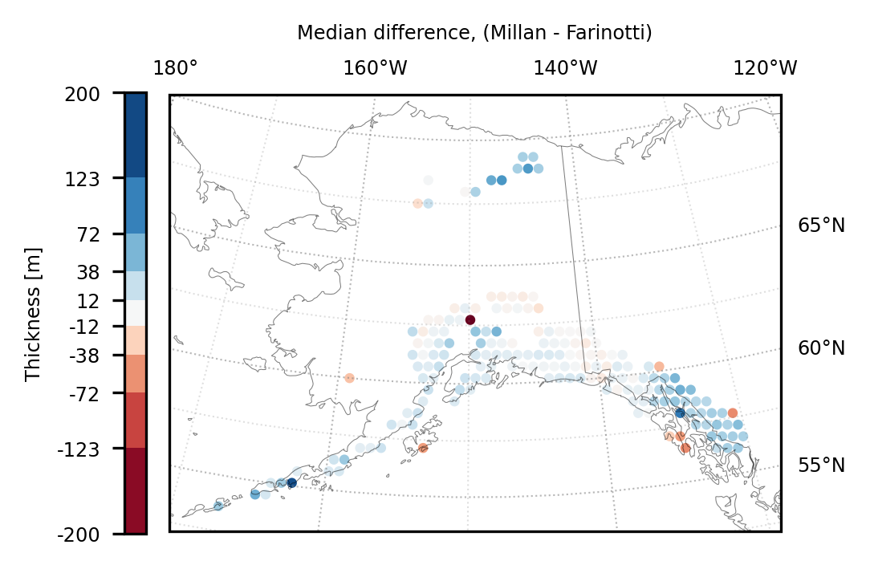

Slide 5
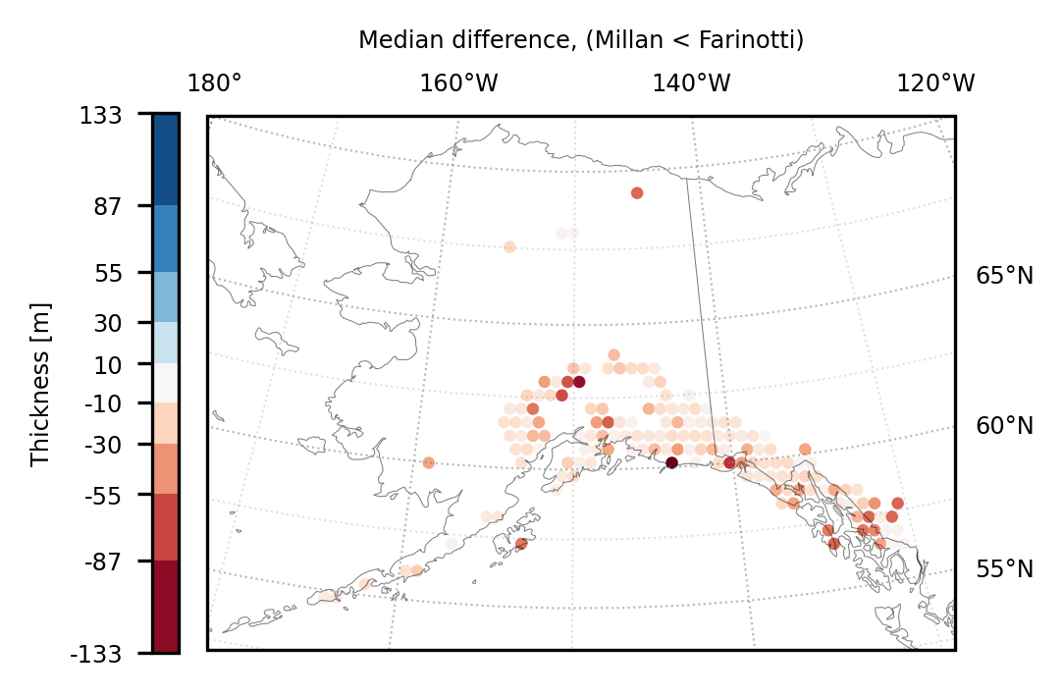

Slide 6
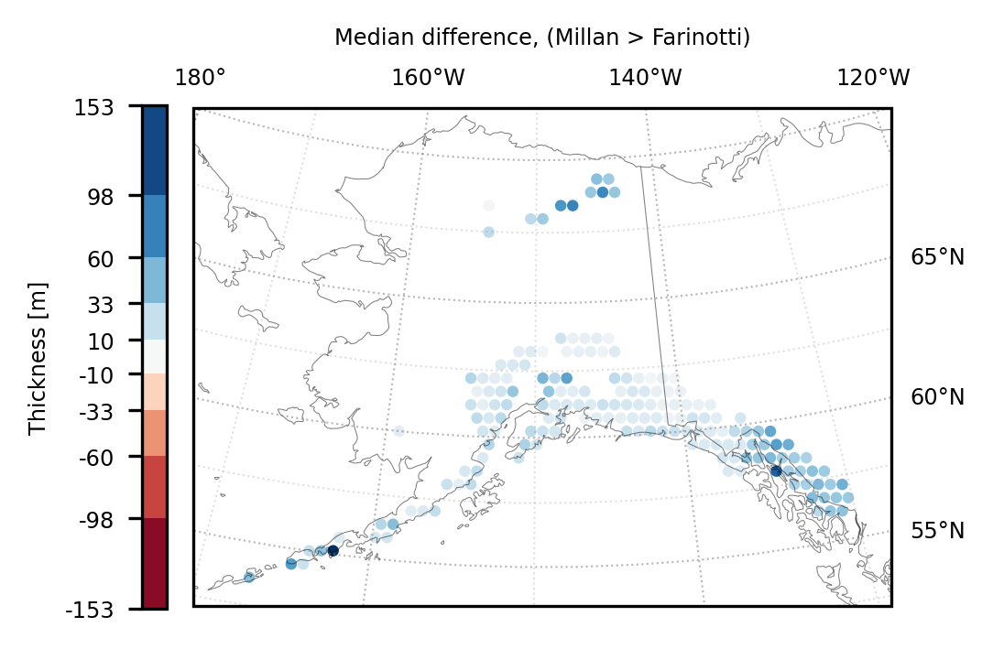

Slide 7
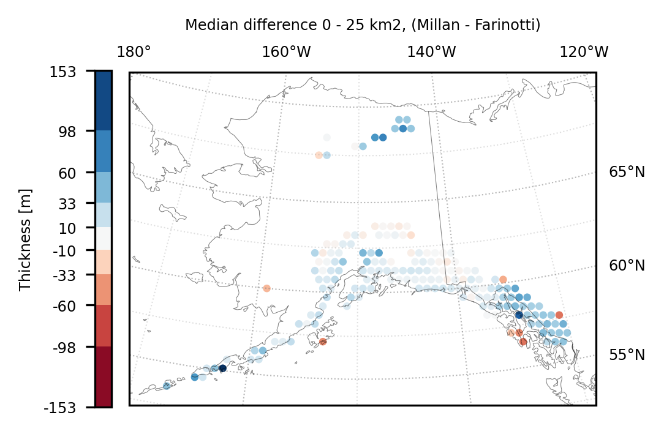

Slide 8
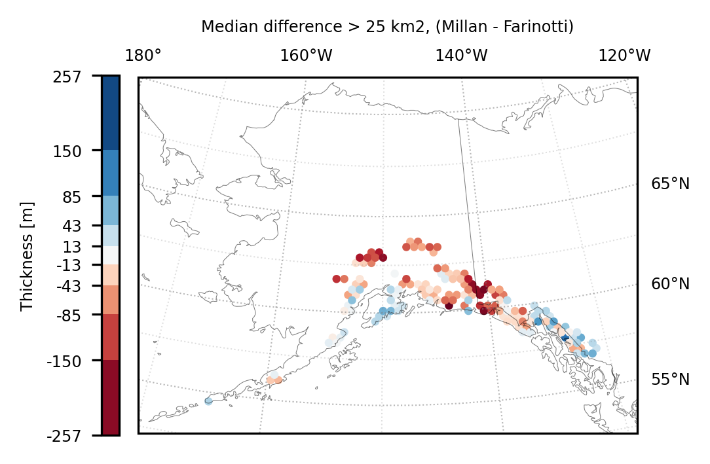

Slide 9
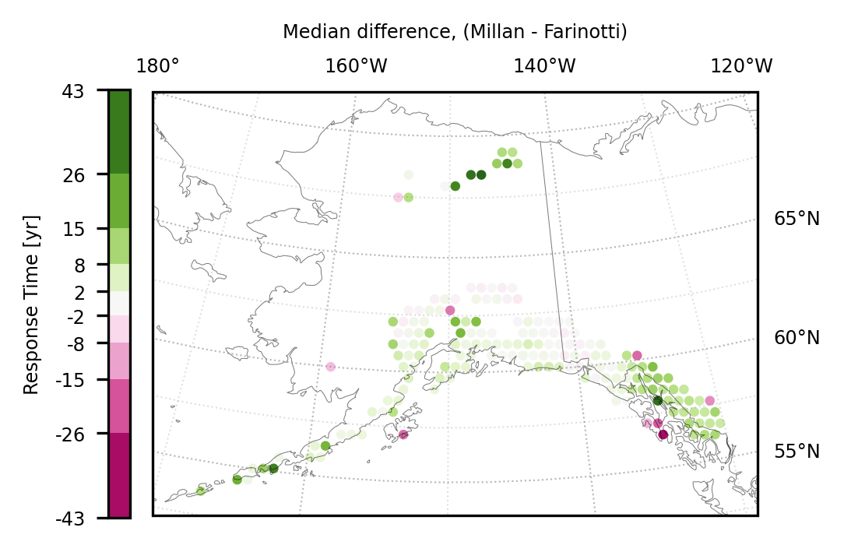

Slide 10
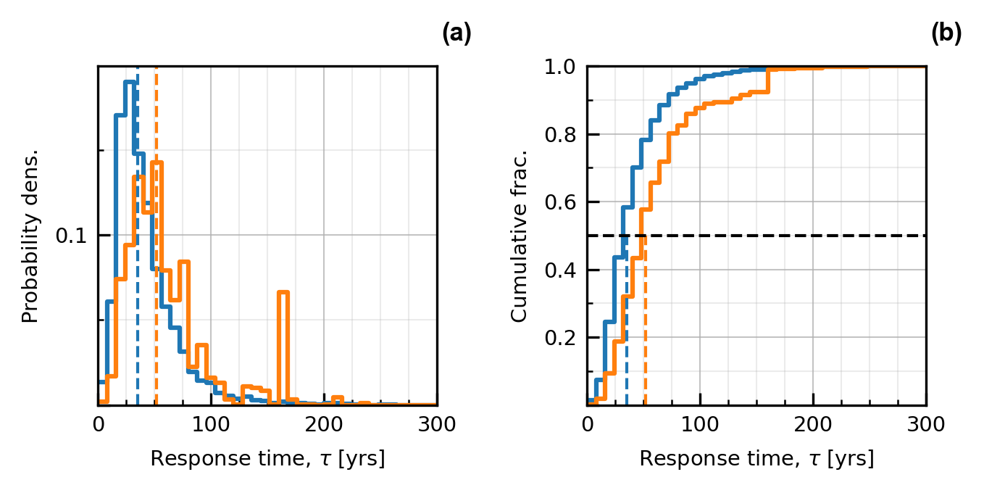
Millan Fig. 6

Slide 11
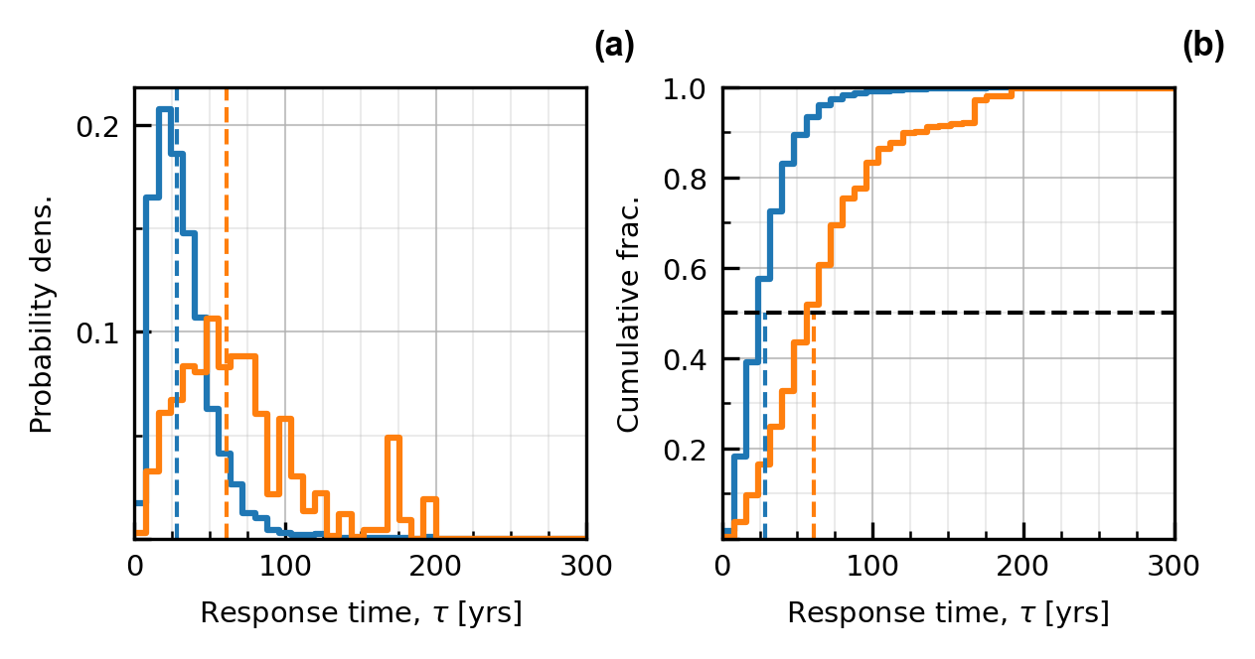
Farinotti Fig. 6

Slide 12
Millan Fig. 8

Slide 13
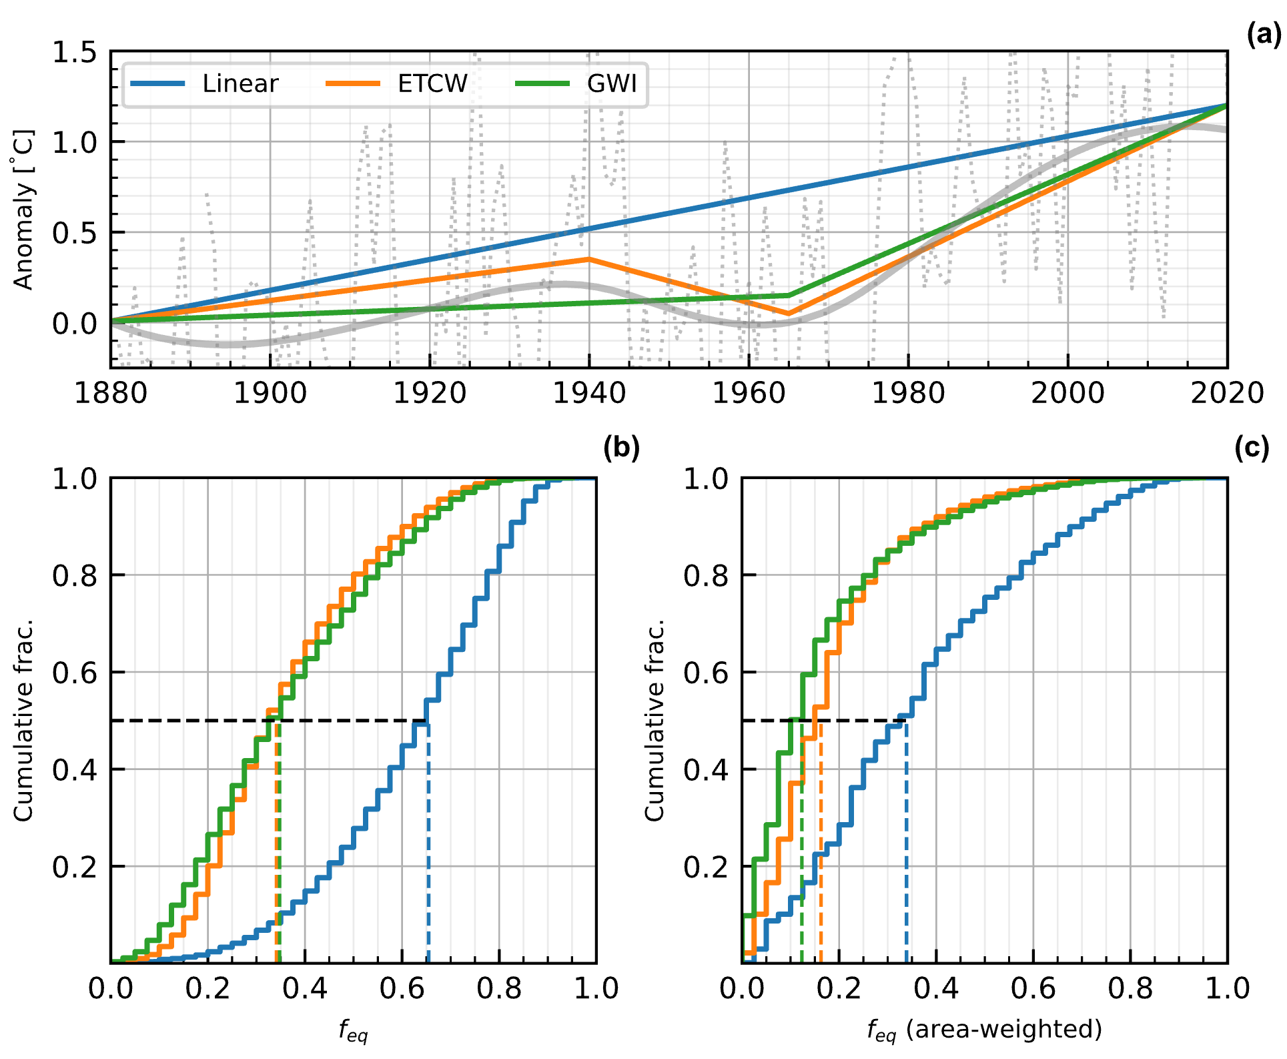
Farinotti Fig. 8

Slide 14
Millan Table A1
 | Count | Bin area | Area | hf | bt | tau | linear_feq | etcw_feq | gwi_feq
Small (1, 5] | 4017 | 12% | 1.75 (1.04, 4.24) | 73 (40, 129) | -2.07 (-4.32, -0.94) | 34 (13, 96) | 0.58 (0.17, 0.84) | 0.29 (0.09, 0.61) | 0.28 (0.05, 0.64)
Medium (5, 25] | 811 | 12% | 8.40 (5.24, 21.06) | 129 (71, 231) | -3.71 (-6.80, -1.87) | 33 (16, 82) | 0.60 (0.22, 0.80) | 0.30 (0.11, 0.54) | 0.29 (0.07, 0.57)
Large (25, 100] | 240 | 17% | 42 (26, 91) | 225 (134, 379) | -5.34 (-8.51, -2.86) | 44 (21, 99) | 0.48 (0.16, 0.74) | 0.23 (0.08, 0.44) | 0.20 (0.05, 0.46)
Mega (100, 250] | 69 | 16% | 149 (104, 238) | 367 (228, 484) | -6.70 (-10.38, -3.64) | 51 (29, 102) | 0.42 (0.15, 0.64) | 0.20 (0.08, 0.34) | 0.17 (0.05, 0.34)
Giga (250, 10000] | 42 | 40% | 447 (293, 1171) | 427 (229, 640) | -7.25 (-10.84, -2.73) | 57 (31, 146) | 0.37 (0.07, 0.62) | 0.18 (0.04, 0.32) | 0.14 (0.02, 0.32)
Total | 5179 | 100% | 2.16 (1.06, 36.90) | 81 (42, 230) | -2.36 (-5.99, -1.00) | 35 (14, 96) | 0.57 (0.17, 0.83) | 0.29 (0.09, 0.59) | 0.27 (0.05, 0.62)
Area-weighted | 5179 |  | 158 (2, 3191) | 331 (70, 644) | -5.68 (-10.23, -1.85) | 52 (19, 167) | 0.41 (0.06, 0.76) | 0.20 (0.03, 0.48) | 0.16 (0.02, 0.51)

Slide 15
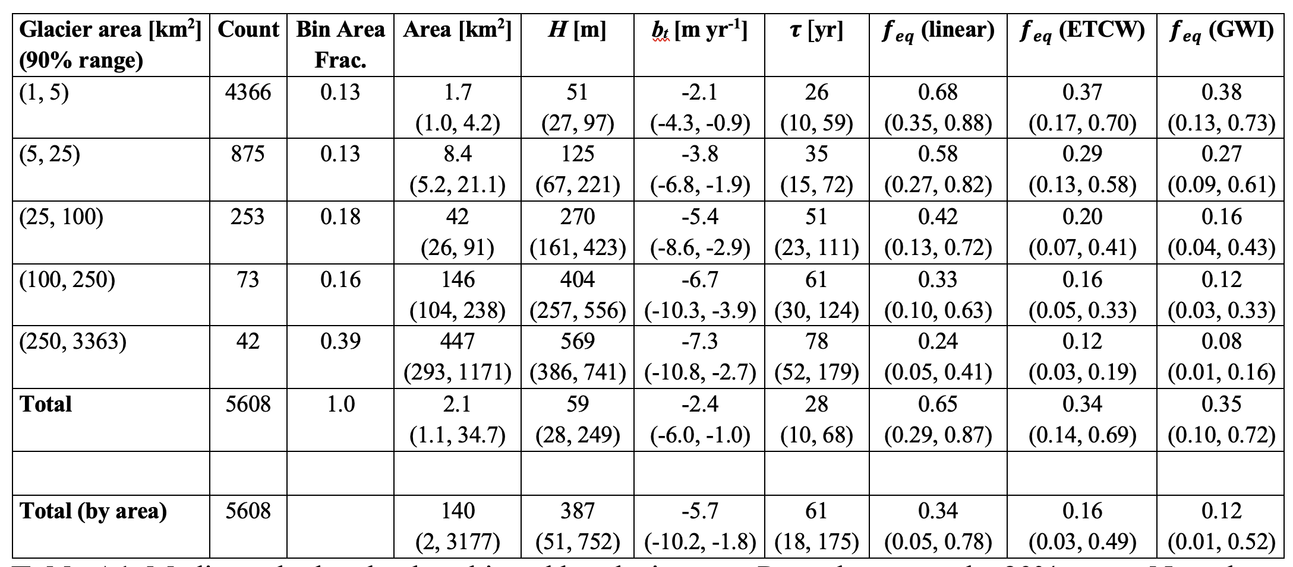
Farinotti Table A1

